Slide 1
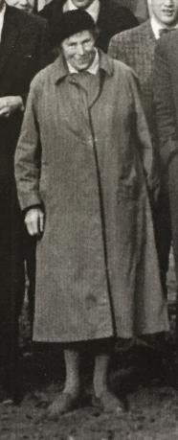
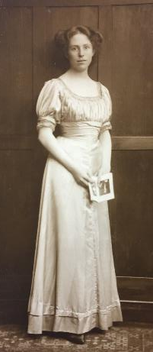



Eileen Mary Lind Hendriks 1887-1978
The woman who made major advances in the understanding of the geology of South-West England
Jenny Bennett, PhD, FGS, FHEA
21st October 2021
Geological Society Discussion Group

Slide 2
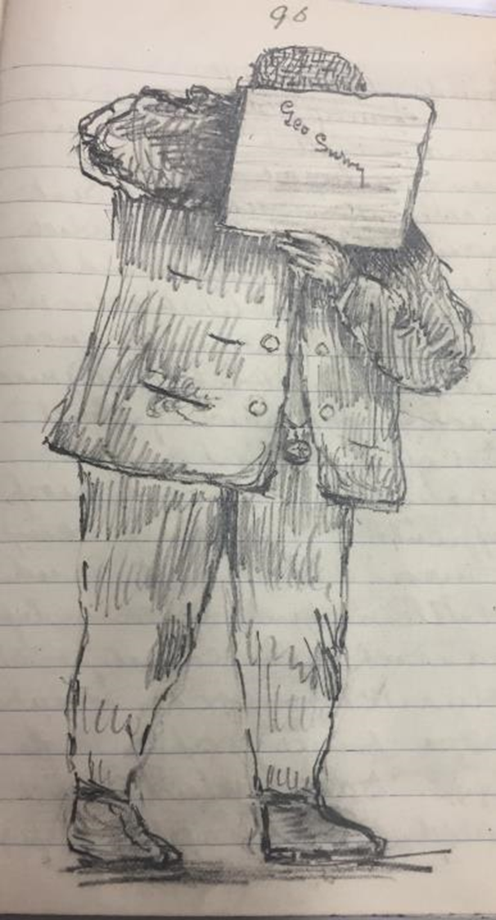
Who was she?
Born 1887 in Edgbaston, only child of Henry and Helena Hendriks
Privately educated at Edgbaston High School for Girls founded by local Quaker and Unitarian families with the aim of providing a “challenging and liberal education for girls”, including sciences.
She is described in 1911 census as ‘Art student’ and was also a keen photographer
Father was interested in geology: a member of the Geologists’ Association from 1898, Eileen joined in 1913 and was an active member until her death. (The Geological Society did not accept women until 1919).
Regular family trips to Cornwall
GSM/GL/He BGS archive

Slide 3
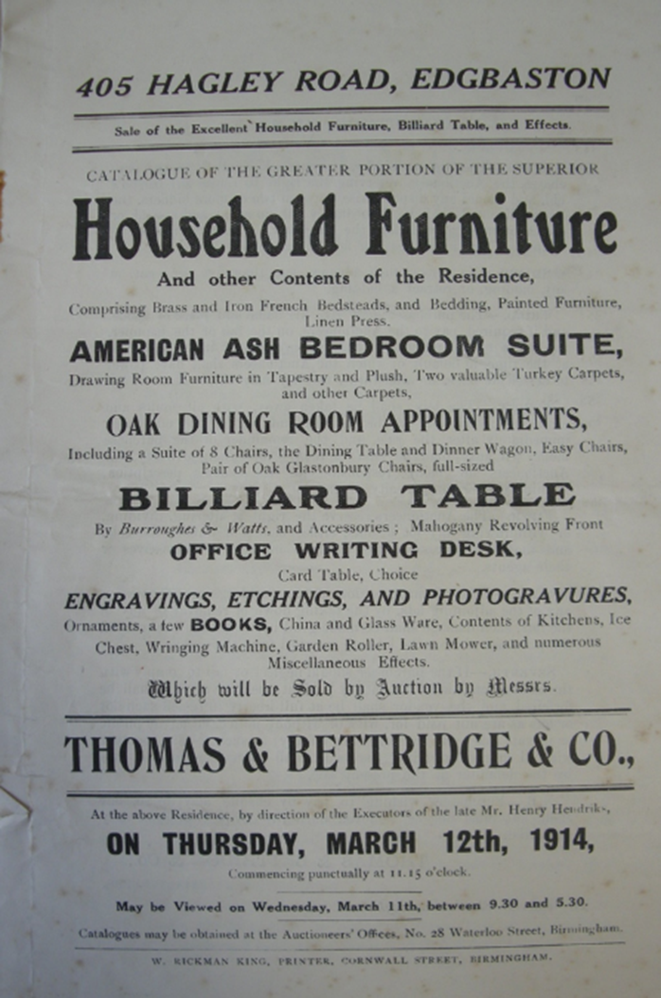
Changes of fortune
Feb. 1st 1914 Father died unexpectedly, aged 58, after a short illness.
March 12th 1914 Business, house and contents sold.
Money left in trust for his widow and daughter.
March 23rd 1914 Probate granted
Aug. 4th 1914 Britain declared war on Germany
Sept. 21st 1914, Eileen awarded scholarship to UCW Aberystwyth at the age of 26.
GSM/GL/He BGS archive

Slide 4

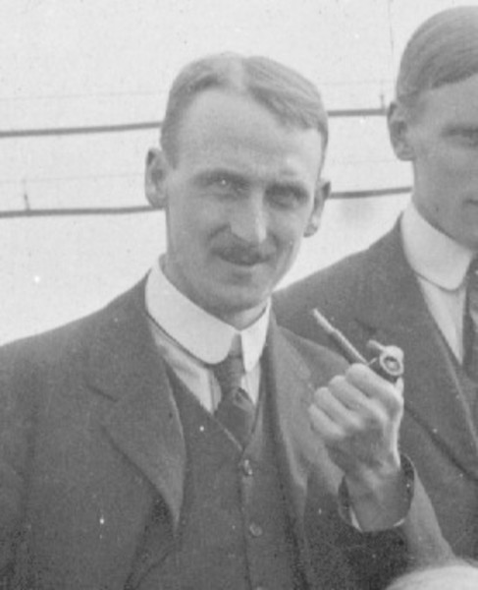
1914-1925
1914-1919 Univ. of Wales Aberystwyth
  Ordinary BSc with courses in zoology, geology and economics.
  Taught geology by O T Jones
  Break of 2 years on war-time work at Glasgow Univ. on steel analysis.
  Graduated in 1919 aged 31
1920 – Appointed Senior Demonstrator in Geology at University of Belfast, under Arthur Dwerryhouse.
  Taught palaeontology, petrology and mineralogy
  Said later this was best time of her life but resigned at end of the year “for personal reasons”
1921 – Museum Assistant in Liverpool
Many other unsuccessful job applications, testimonials from Jones, Dwerryhouse, Laurie and Hodkin.
1923/4 – Mapped Lower Palaeozoic rocks in South Cardiganshire, mentored by O T Jones. Paper published in Geological Magazine.
1925 - based at Imperial College with W. W. Watts looking at the Cornish ‘killas’ superficially similar to the south Cardiganshire rocks
O T Jones from BGS archive

Slide 5
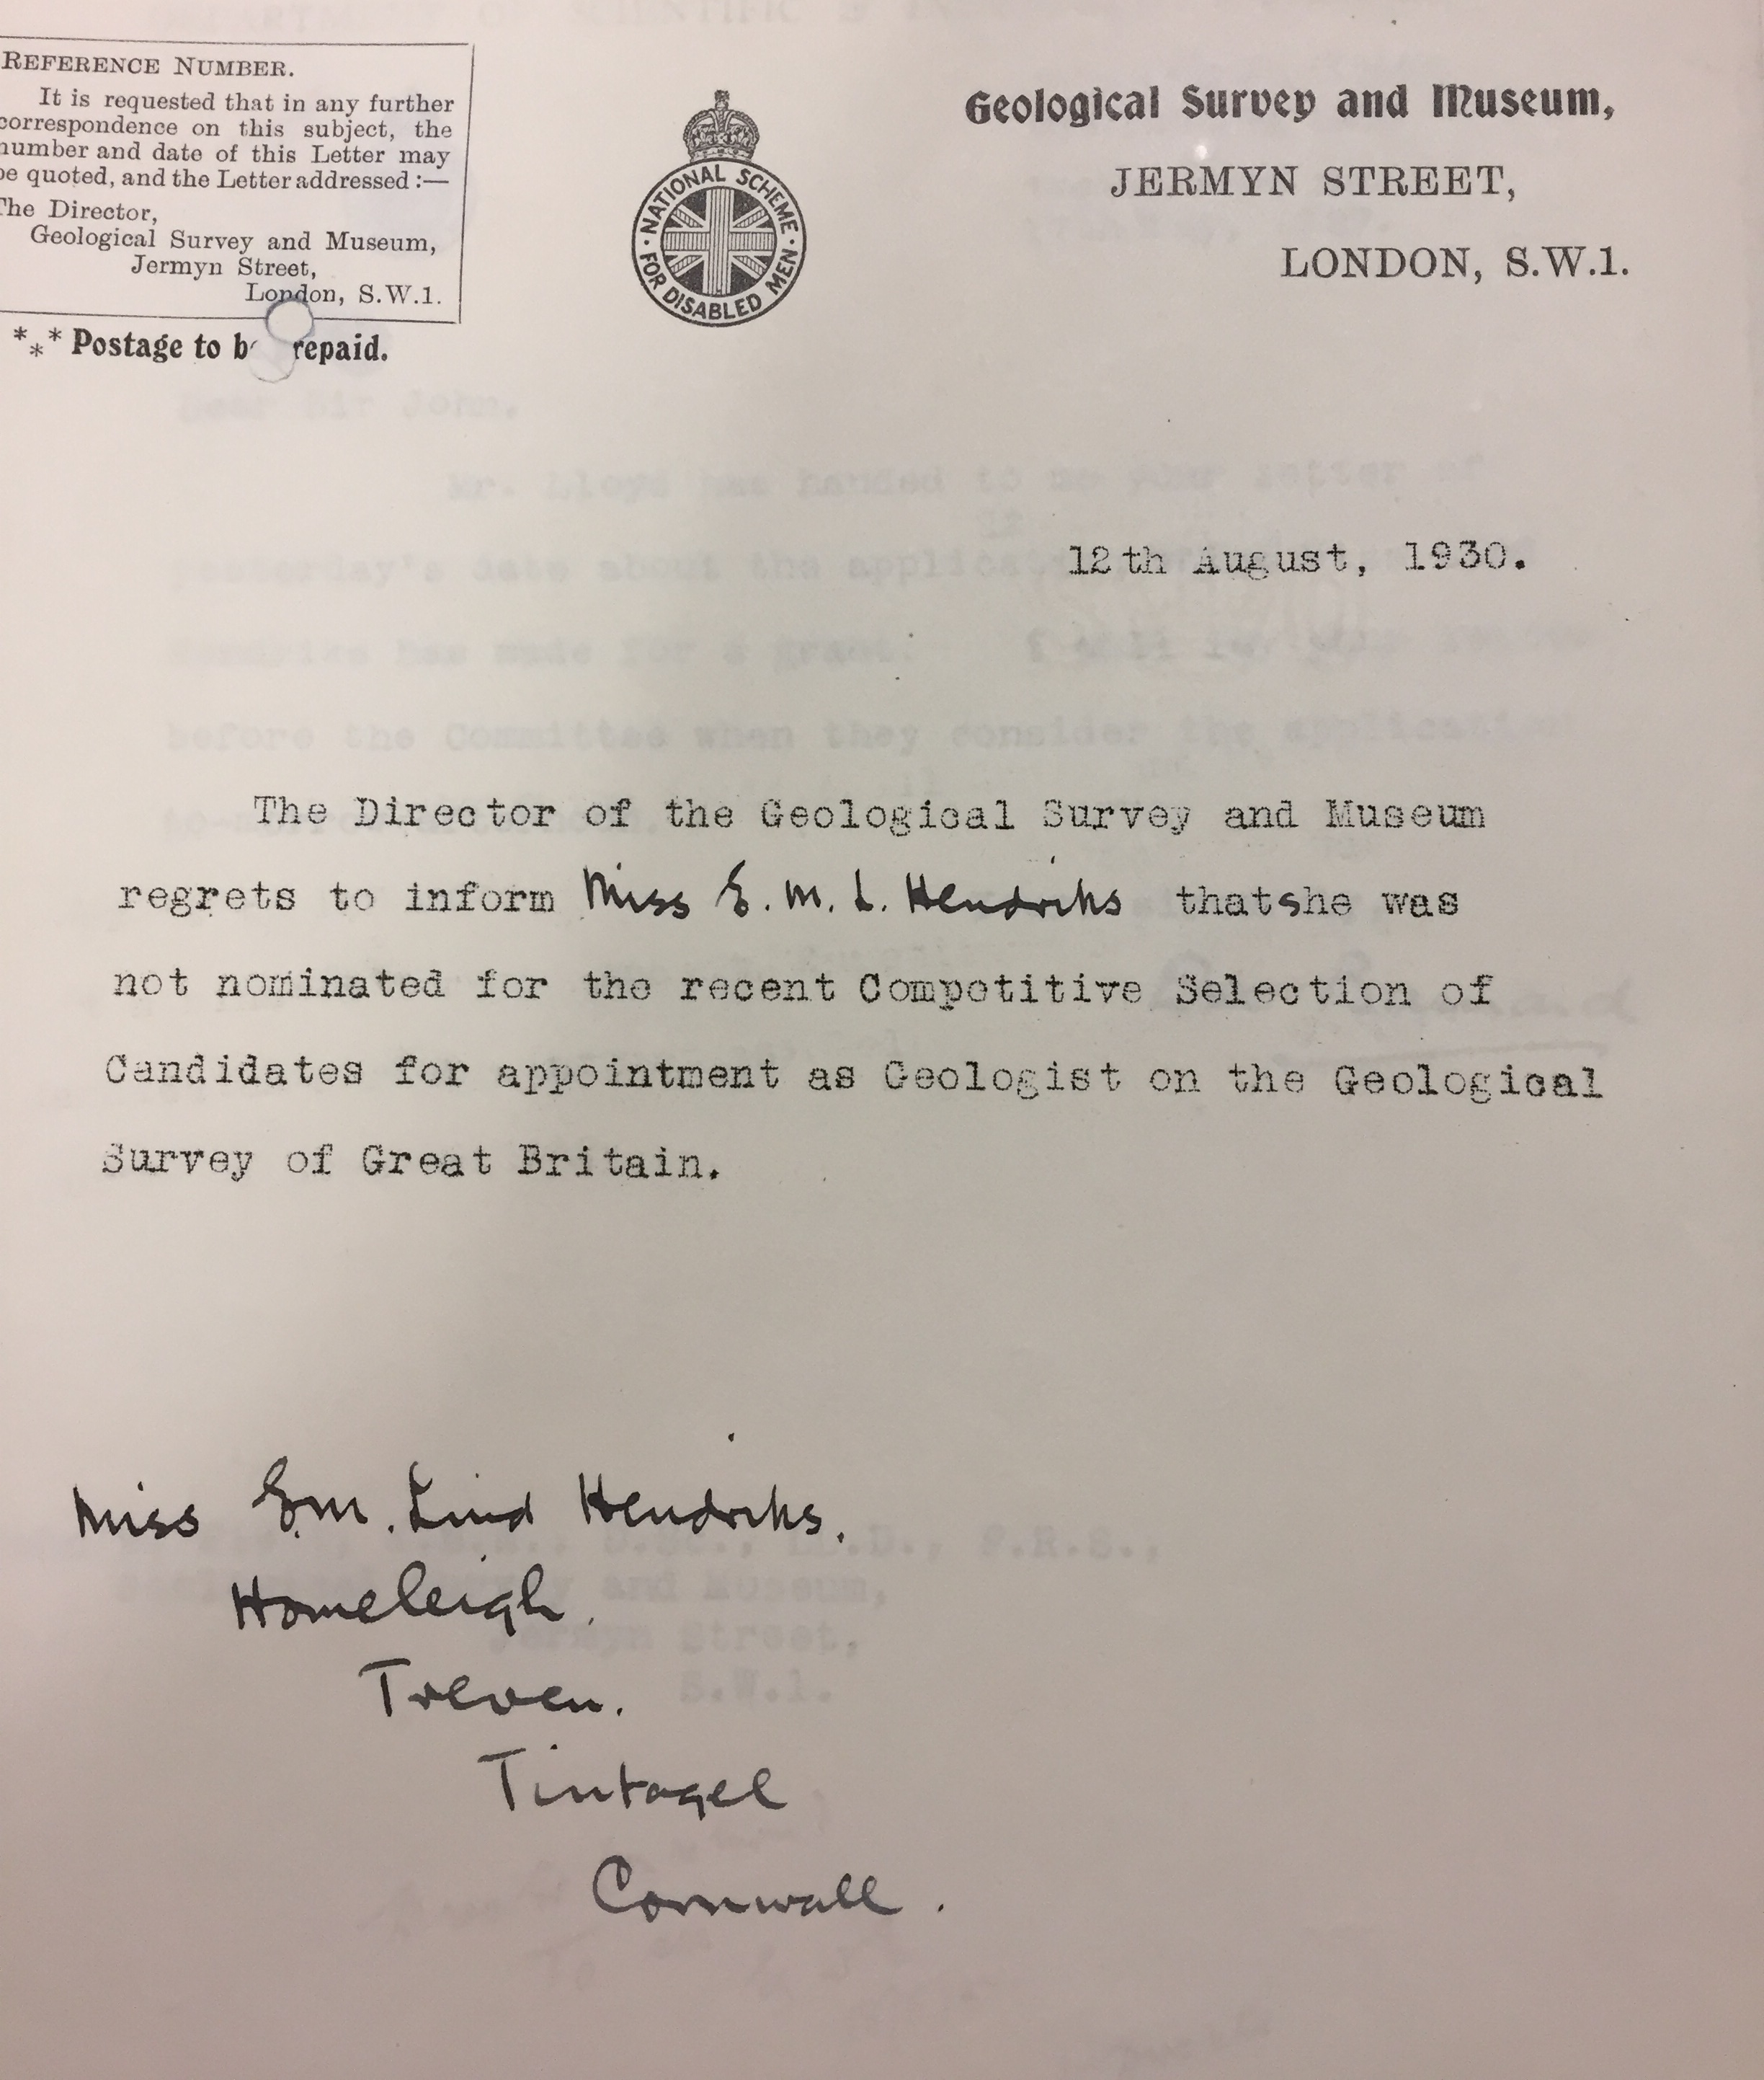
Hendriks and the Geological Survey
From 4/10/26 to 31/3/27 and from 2/1/28 to 31/3/28 she produced a guide for lecturers and teachers. Published in 1928 as “Classified Geological Photographs”
In June 1930 two geologist staff positions were advertised. Sent an application form by Flett but failed to get an interview.
She was the first woman to apply for a position as a geologist with the Survey, but really had no chance.
Gender may well have played a part, but she was 42 - well over the age limit, had no honours degree, and had not completed her PhD.
The successful candidates were T.N. George and W.C.C. Campbell both of whom were in their twenties, had their PhDs and who both went on to have distinguished careers

Slide 6
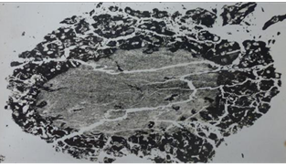
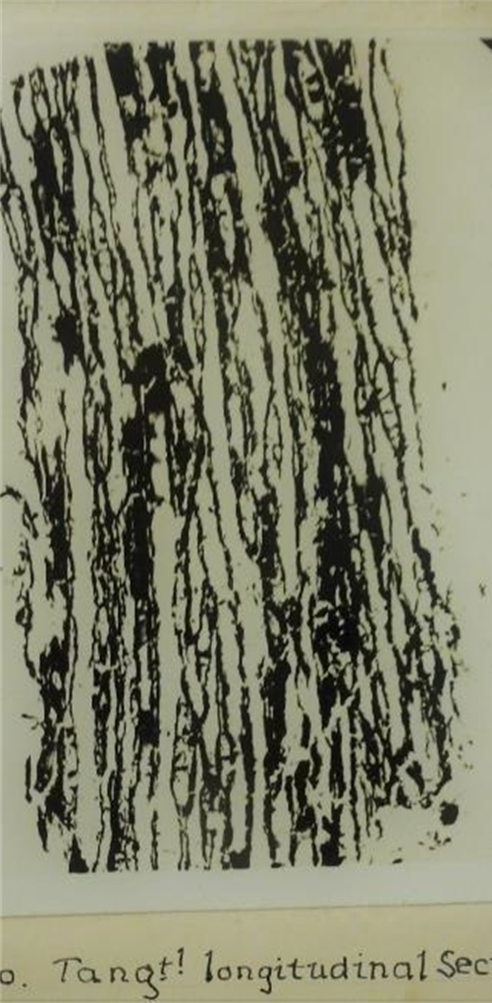
Mapping in Cornwall
Looked at the Cornish ‘killas’ which appeared superficially similar to the south Cardiganshire rocks
Early maps by De la Beche show these as ‘grauwacke’ - contained Ordovician fossils in quartzites and Silurian fossils in limestones.
Lizard Memoir (1912) mapped them as mainly Ordovician and older, with youngest beds Devonian
Discovered plant fossils (Dadoxylon) in the Meneage and Roseland which proved the rocks could not be older than the Middle Devonian.
Dadoxylon hendriksi and Machœracanthus hendriksi (a species of fish) named after her.
Demonstrated that fossiliferous Ordovician and Silurian strata present had been introduced by thrusting.
Hendriks named the strata with the hendriksi fauna the “Gramscatho Beds”. On the basis of her work, the succession and structure proposed by Hill and Flett (1912) for the Lizard was discarded and, in 1933, a new interpretation substituted.
Lang 1929

Slide 7
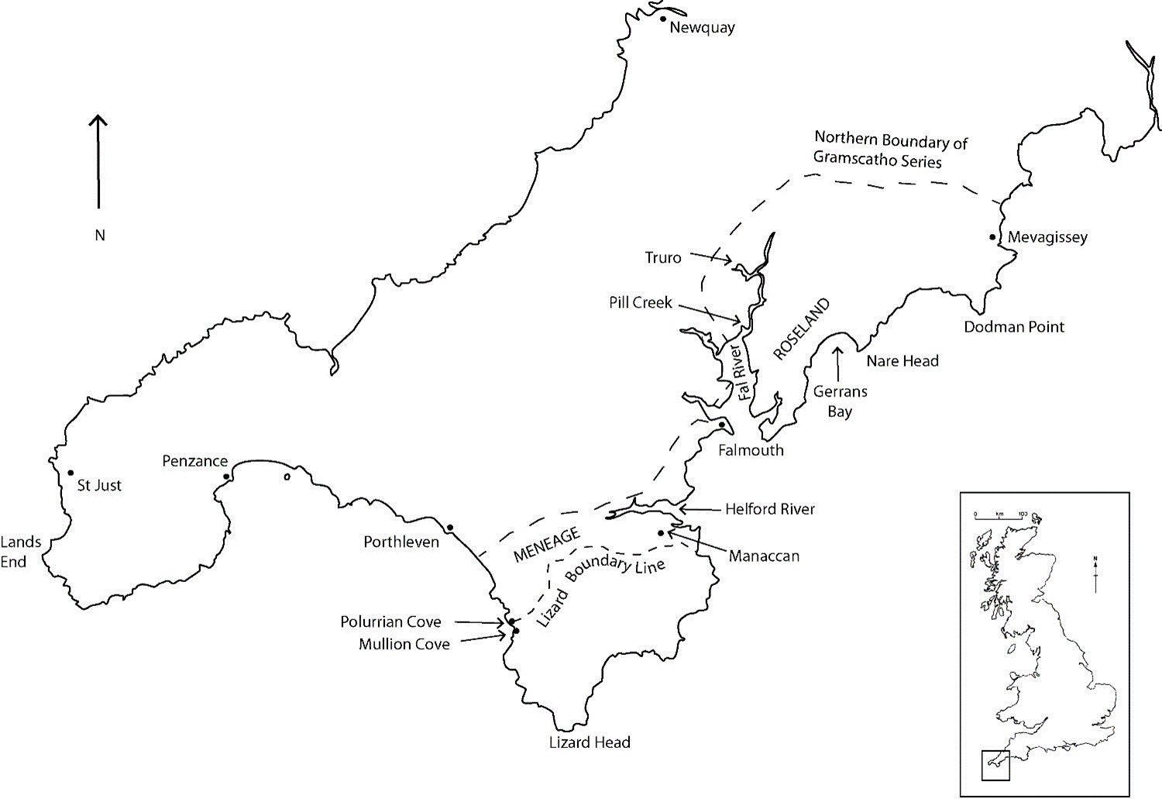
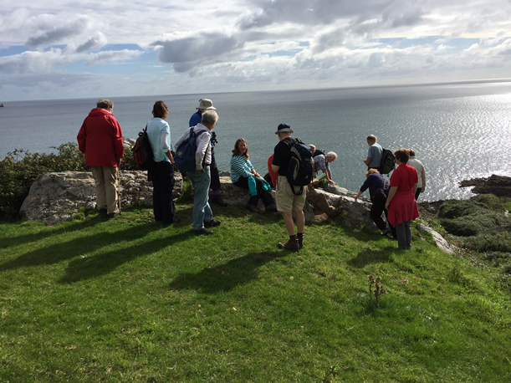
Lizard Memoir 1912 |  | Hendriks mapping
Manaccan | Devonian | Gramscatho | U. Devonian
Veryan | Ordovician | Gramscatho | U/M. Devonian
Portscatho | Ordovician or older | Gramscatho | M. Devonian
Falmouth | ------≈------ | Gramscatho | M. Devonian
Mylor | ------≈------ | Mylor | M/L. Devonian

Slide 8
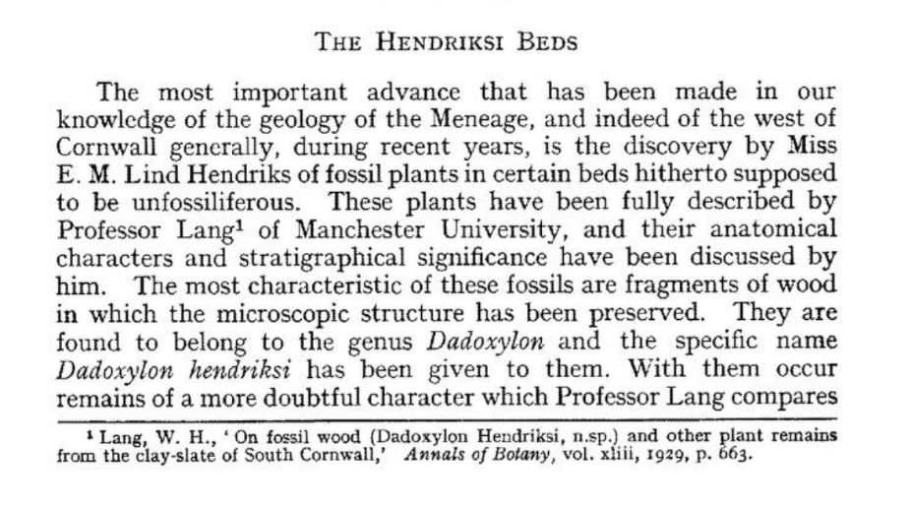
Flett, J.S. 1933. The geology of the Meneage. In: Summary of Progress of the Geological Survey of Great Britain and the Museum of Practical Geology for the year 1932, part 2. 1933. HMSO, London, 1–14.
Flett, J. S. 1933

Slide 9
Difficulties - with Publication and with finances
PhD awarded early 1932 and soon afterwards Hendriks and her mother made permanent move to Cornwall.
Advised by Flett and others that she had material for 2 or 3 papers.
Nearly 4 years before a paper was submitted to the Geological Society. Read at Society in December 1935 and well received
Script of about 20 000 words submitted. Reviewed by Henry Dewey and major revisions requested, reducing length by half, removing many illegible diagrams and plates already published
2 years later still not finalised and worked on by Society’s secretary.
Eventually published in 1937, some 12 years after she had started work
Delay meant most of her conclusions were already well known and she failed to get the recognition she deserved.
Now 50 years old and chances of getting a geological job remote

Slide 10
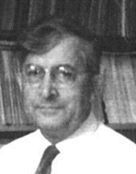
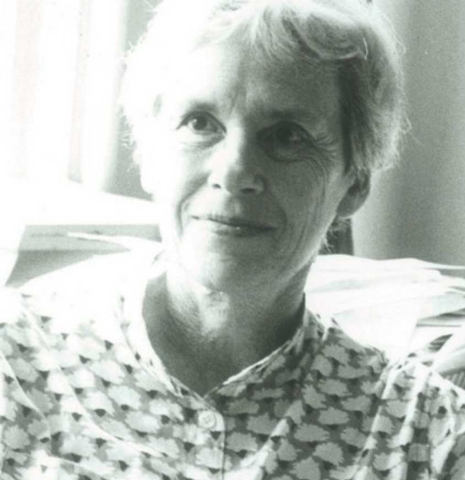

The “Conferences of Geologists Working in SW England” led to the formation of the Ussher Society in 1962 and a Geological Survey Office opened in Exeter in 1966
Initially suspicious, she eventually cooperated with the ‘incomers’ and was highly respected.
Michael House. Particularly close working relationship and friendship
Janet Watson wrote in 1967 “Any number of people write expert papers on small areas but nobody but yourself seems ready to think in terms of the whole peninsula”.
Letters archived at GSM/GL/He/). BGS

Slide 11
Geological section along the cliffs north of Nare Head, based on Hendriks (1937) with an interpretation below. From Holwill et al. (1969).
Stratigraphy and structure revised in the light of the conodont dates (Hendriks 1970). Two principal tectonic units distinct in sedimentary facies, where a nappe to the south, which included the Ordovician quartzites, overrode slightly metamorphosed assemblages to the north.
The thrust at the base of the nappe was associated with a broad shatter belt – the ‘crush zone’ of earlier publications.

Slide 12
Degrees and Distinctions
1919 BSc University of Wales, Aberystwyth
1931 DIC Imperial College, London
1932 PhD University of London
1945 Fellow of the Geological Society
1949 William Bolitho Silver Gilt Medal from the Royal Geological Society of Cornwall
1949 to 1956 Vice-President, Royal Geological Society of Cornwall
1953 Vice-President of the newly-formed Lizard Field Club
1953 Civil List Pension awarded
1958 Moiety of the Lyell Fund from the Geological Society
1965 R H Worth Prize from the Geological Society
1967 Honorary Membership of the Ussher Society (1st recipient)

Slide 13
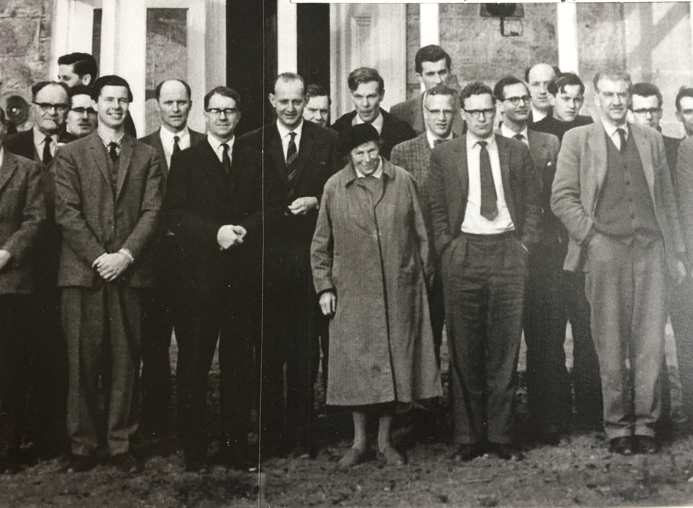
1965 Ussher Society meeting at St Austell

Slide 14
Mather, J. D. & Bennett, J. A. 2021. Eileen Mary Lind Hendriks (1887–1978), whose meticulous research resolved the Palaeozoic stratigraphy and structure of south-west England. In: Uncovering the historical contribution of women in the geosciences: discovering forgotten histories. Geological Society, London, Special Publications, 506, 171-185. First published online 20 August 2020, https://doi.org/10.1144/SP506-2019 194.
Mather, J. D. 2021. Hendriks, Eileen Mary Lind (1887-1978). Oxford Dictionary of National Biography. Published online: 09 January 2021. https://doi.org/10.1093/odnb/ 9780198614128.013.

